Slide 1

读写结合测试任务的评分
李京南
2020.11.12

Slide 2
Direction:
Read the following text about learning a second language and write an essay on the same topic. You should
make sure that what you write is a COMPLETE essay with all the necessary parts coherently connected;
write NO LESS THAN 200 words;
summarize the main points of the provided text in YOUR OWN WORDS;
comment on the points you summarize, and present your viewpoint with SPECIFIC REASAONS AND EVIDENCES.
You can support yourself with information from the provided text, but you need to use your own words. Direct copying from the text results in grade deduction. Marks will be awarded for content relevance, content sufficiency, organization, and language quality. Failure to follow the above instructions may result in a loss of marks.

Slide 3
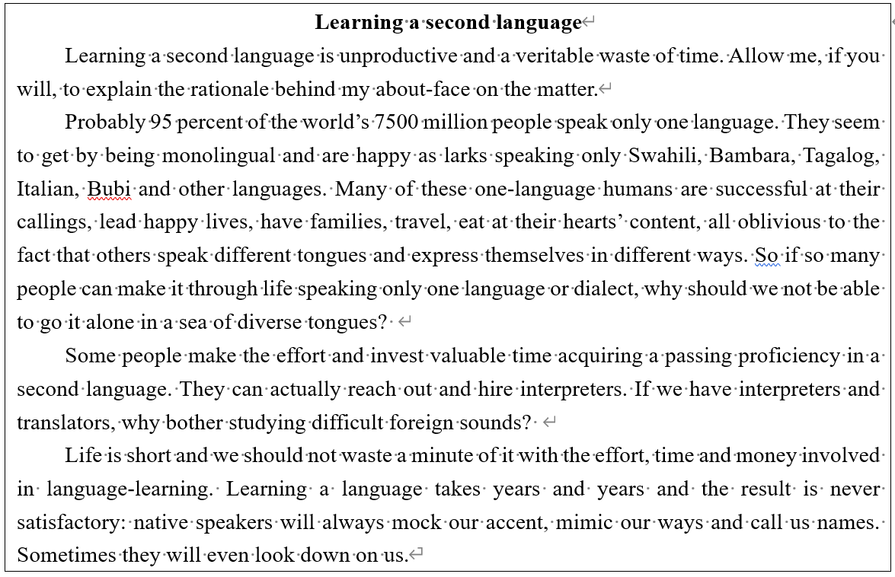

Title?
Now, please write an essay which gives the important information provided in the text, and your views on the topic.

Slide 4
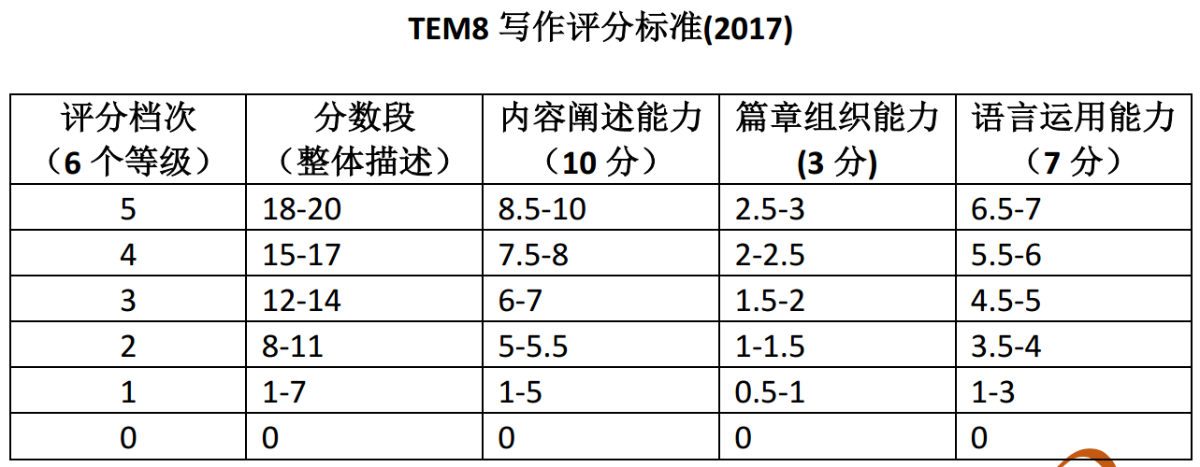
?

Slide 5
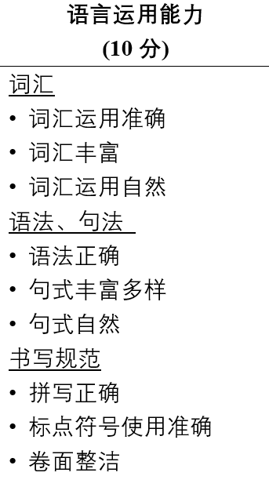
Second language, as a kind of communicative skill, is sure to enhance the speaker’s social competitiveness. If you ever have a glance at the information of job recruitment on the Internet, you will find that a second language is always preferred, especially in those leading enterprises and international companies. In another word, learning a second language can bring more possibilities for the career development and even more practically, more incomes. So with a view of globalization trend and individual career development, happy though monolinguals’ lives can be, why not be bilingual and have happier lives? The answer is clear.

Slide 6
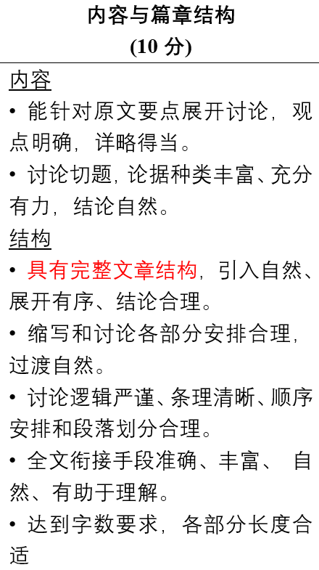
When it comes to the question “Should we learn the second language? ”, answers vary. The author of the excerpt, apparently, denied the necessity of second language learning by declaiming that first language already enables monolinguals to live happy lives and it is a waste of time to learn a second language since no learner can compare their language proficiency to native speakers and have the risk of being mocked. Though this idea seems reasonable to some limited degree, I disagree with it because of its neglection on the benefits of second language learning.

Slide 7
Second language, as a kind of communicative skill, is sure to enhance the speaker’s social competitiveness. If you ever have a glance at the information of job recruitment on the Internet, you will find that a second language is always preferred, especially in those leading enterprises and international companies. In another word, learning a second language can bring more possibilities for the career development and even more practically, more incomes. So with a view of globalization trend and individual career development, happy though monolinguals’ lives can be, why not be bilingual and have happier lives? The answer is clear.

Slide 8
There might be disapprovals arguing that only when the second language learners are of high proficiency level can they possess more comprehensive competitiveness, but they ignore the fact that the learning process itself can also improve one’s ability. The learning of a second language is not merely the mechanized acceptance of linguistic knowledge, but also a challenging but rewarding training on thinking mode and learning ability. Statistics from various experiments have showed that learning a second language equips learners the so-called bilingual advantages: more innovative thinking pattern and more flexible cognitive ability, for example the ability of information transformation.

Slide 9
From here we see that unlike what the excerpt belittled the importance of second language learning, it is of great benefits and necessity. I wish that all the second language learners can be aware and proud of what they are doing and enjoy the subsequent achievement from second language learning.

Slide 10
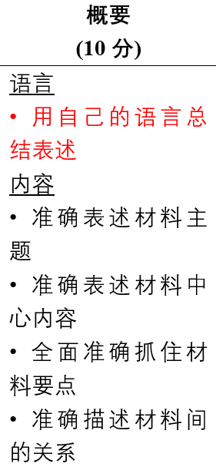
When it comes to the question “Should we learn the second language? ”, answers vary. The author of the excerpt, apparently, denied the necessity of second language learning by declaiming that first language already enables monolinguals to live happy lives and it is a waste of time to learn a second language since no learner can compare their language proficiency to native speakers and have the risk of being mocked. Though this idea seems reasonable to some limited degree, I disagree with it because of its neglection on the benefits of second language learning.

Slide 11
Learning a second language is unproductive and a veritable waste of time. Allow me, if you will, to explain the rationale behind my about-face on the matter.
Probably 95 percent of the world’s 7500 million people speak only one language. … So if so many people can make it through life speaking only one language or dialect, why should we not be able to go it alone in a sea of diverse tongues?
Some people make the effort and invest valuable time acquiring a passing proficiency in a second language. They can actually reach out and hire interpreters. If we have interpreters and translators, why bother studying difficult foreign sounds?
Life is short and we should not waste a minute of it with the effort, time and money involved in language-learning. Learning a language takes years and years and the result is never satisfactory: native speakers will always mock our accent, mimic our ways and call us names. Sometimes they will even look down on us.

Slide 12
 | 9~10 | 7~8 | 5~6 | 3~4 | 1~2 | 0
语言 | • 用自己的语言总结表述 | • 大部分内容… | • 一半以上的内容用自己的语言总结表述 | • 大部分照搬原文表达 | • 基本照抄原文语句 | 空白或仅抄写部分原文内容
内容 | • 准确表述材料主题 |  | • 基本… | • 材料主题和中心内容与原文相关，但有较大偏差 | • 材料主题和中心内容与原文有一点相关
 | • 准确表述材料中心内容 | • 较… | • 表述材料中心内容有一些偏差 | • 基本不能总结要点，仅是罗列部分细节 | • 不能总结要点，仅是罗列部分细节
 | • 全面准确抓住材料要点 | • 材料要点有少量遗漏 | • 材料要点部分遗漏
 | • 准确描述材料间的关系 | • 较… | • 未能描述材料间的关系

Slide 13
Sample 2
The excerpt explains why learning a second language is unproductive and a veritable waste of time. Here are its augmentations. To begin with, being monolingual is just as happy and successful as those who speak more than one language. Secondly, why those people bother learning a second language when translators and interpreters are easy to get? Thirdly, learning a second language requires investing much time and money. Nevertheless, non-native speakers will never be proficient as those native speakers and will be mocked regarding heavy accent or unprofessional expressions. …

Slide 14
Sample 2
The excerpt explains why learning a second language is unproductive and a veritable waste of time. Here are its augmentations.
Learning a second language is unproductive and a veritable waste of time. Allow me, if you will, to explain the rationale behind my about-face on the matter.

Slide 15
Sample 2
To begin with, being monolingual is just as happy and successful as those who speak more than one language.
Probably 95 percent of the world’s 7500 million people speak only one language. They seem to get by being monolingual and are happy as larks speaking only …. Many of these one-language humans are successful at their callings, lead happy lives, have families, travel, eat at their hearts’ content, all oblivious to the fact that others speak different tongues and express themselves in different ways. …

Slide 16
Sample 2
Secondly, why those people bother learning a second language when translators and interpreters are easy to get?
Thirdly, learning a second language requires investing much time and money.
Nevertheless, non-native speakers will never be proficient as those native speakers and will be mocked regarding heavy accent or unprofessional expressions.
Some people make the effort and invest valuable time acquiring a passing proficiency in a second language. They can actually reach out and hire interpreters. If we have interpreters and translators, why bother studying difficult foreign sounds?
Life is short and we should not waste a minute of it with the effort, time and money involved in language-learning. Learning a language takes years and years and the result is never satisfactory: native speakers will always mock our accent, mimic our ways and call us names. Sometimes they will even look down on us.

Slide 17
Sample 3
At the beginning of the excerpt, the author brings forth his main viewpoint, namely, “learning a second language is worthless and fruitless”. Then, he illustrates the reasons of this huge reversal in attitude towards this matter. The illustrations are as follows.
Firstly, mastering more other languages can not improve our quality of life. Speaking only one language is enough for us to lead a quite normal even happy life. In other words, the living standard of monolingual people is as same as that of polylingual people.
Secondly, since there are professional translators and interpreters. It is unnecessary for us to spend much time and energy on mastering a second language.
Thirdly, learning a second language is undoubtedly a time-consuming task. Even if we really master a foreign language, few of us can speak it out like a native speaker. On the contrary, native speakers will always make fun of our accent even despise us.

Slide 18
Sample 3
At the beginning of the excerpt, the author brings forth his main viewpoint, namely, “learning a second language is worthless and fruitless”. Then, he illustrates the reasons of this huge reversal in attitude towards this matter. The illustrations are as follows.
Learning a second language is unproductive and a veritable waste of time. Allow me, if you will, to explain the rationale behind my about-face on the matter.

Slide 19
Sample 3
Firstly, mastering more other languages can not improve our quality of life. Speaking only one language is enough for us to lead a quite normal even happy life. In other words, the living standard of monolingual people is as same as that of polylingual people.
Probably 95 percent of the world’s 7500 million people speak only one language. … So if so many people can make it through life speaking only one language or dialect, why should we not be able to go it alone in a sea of diverse tongues?

Slide 20
Sample 3
Secondly, since there are professional translators and interpreters. It is unnecessary for us to spend much time and energy on mastering a second language.
Some people make the effort and invest valuable time acquiring a passing proficiency in a second language. They can actually reach out and hire interpreters. If we have interpreters and translators, why bother studying difficult foreign sounds?

Slide 21
Sample 3
Thirdly, learning a second language is undoubtedly a time-consuming task. Even if we really master a foreign language, few of us can speak it out like a native speaker. On the contrary, native speakers will always make fun of our accent even despise us.
Some people make the effort and invest valuable time acquiring a passing proficiency in a second language. They can actually reach out and hire interpreters. If we have interpreters and translators, why bother studying difficult foreign sounds?
Life is short and we should not waste a minute of it with the effort, time and money involved in language-learning. Learning a language takes years and years and the result is never satisfactory: native speakers will always mock our accent, mimic our ways and call us names. Sometimes they will even look down on us.

Slide 22
Sample 4
语言：全部 大部分 一半 小部分 无
内容：准确 较 基本 基本不 不
主题
中心内容
要点
要点间关系
The excerpt explains why we shouldn't learn a second language, the first reason is thinking that most people in the world only know the first language and language and learning a second language is a indeed that waste of time. Why not turn the trouble to a capable person such like interpreters ? The other reason is that on matter how we learn a second language, others will mock our accent.

Slide 23
 | 9~10 | 7~8 | 5~6 | 3~4 | 1~2 | 0
语言 | • 用自己的语言总结表述 | • 大部分内容… | • 一半以上的内容用自己的语言总结表述 | • 大部分照搬原文表达 | • 基本照抄原文语句 | 空白或仅抄写部分原文内容
内容 | • 准确表述材料主题 |  | • 基本… | • 材料主题和中心内容与原文相关，但有较大偏差 | • 材料主题和中心内容与原文有一点相关
 | • 准确表述材料中心内容 | • 较… | • 表述材料中心内容有一些偏差 | • 基本不能总结要点，仅是罗列部分细节 | • 不能总结要点，仅是罗列部分细节
 | • 全面准确抓住材料要点 | • 材料要点有少量遗漏 | • 材料要点部分遗漏
 | • 准确描述材料间的关系 | • 较… | • 未能描述材料间的关系

